Slide 1
ICES-Tech Prava
Datathon for begineers

Slide 2
DIFFERENT CHARTS IN RELATION TO THE VOTES RECEIVED BY EACH CANDIDATE IS:
CENTRAL ELECTION 2079 RESULT ANALYSIS FROM KASKI, LAMJUNG,SYANGJYA,BAGLUNG,

Slide 3
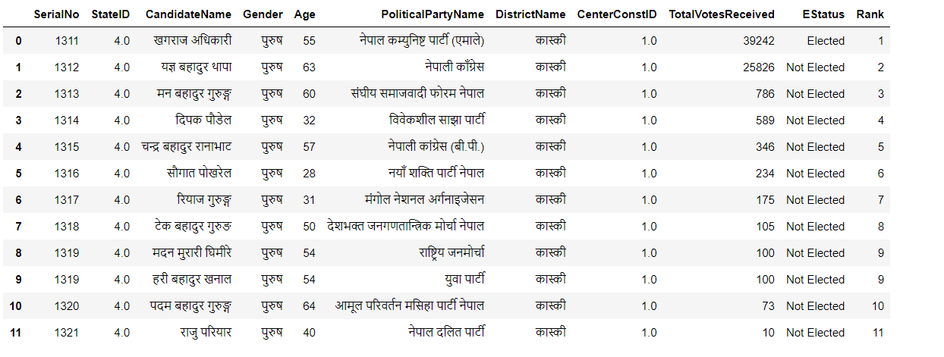
KASKI DATA FROM AREA 1:

Slide 4
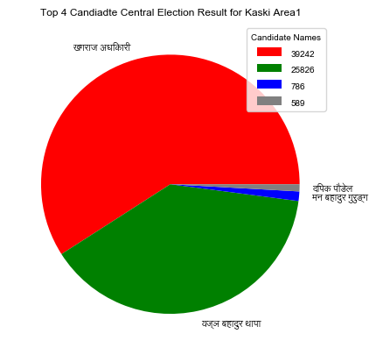

Slide 5
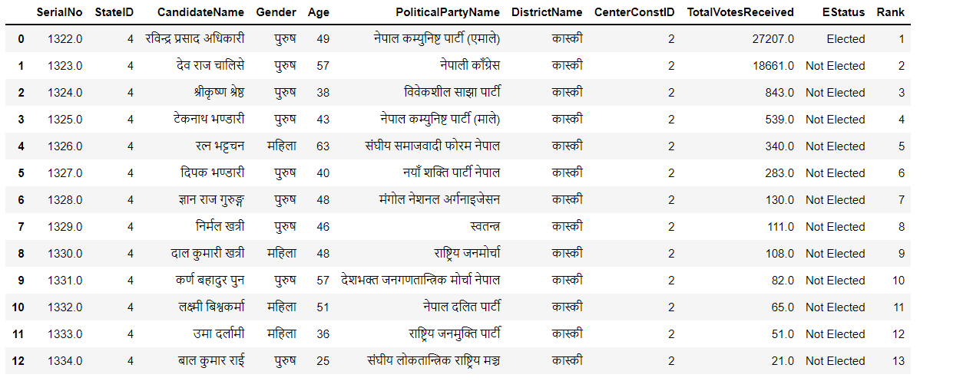
KASKI DATA FROM AREA 2:

Slide 6
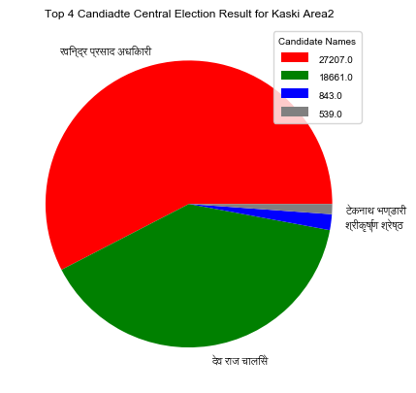

Slide 7
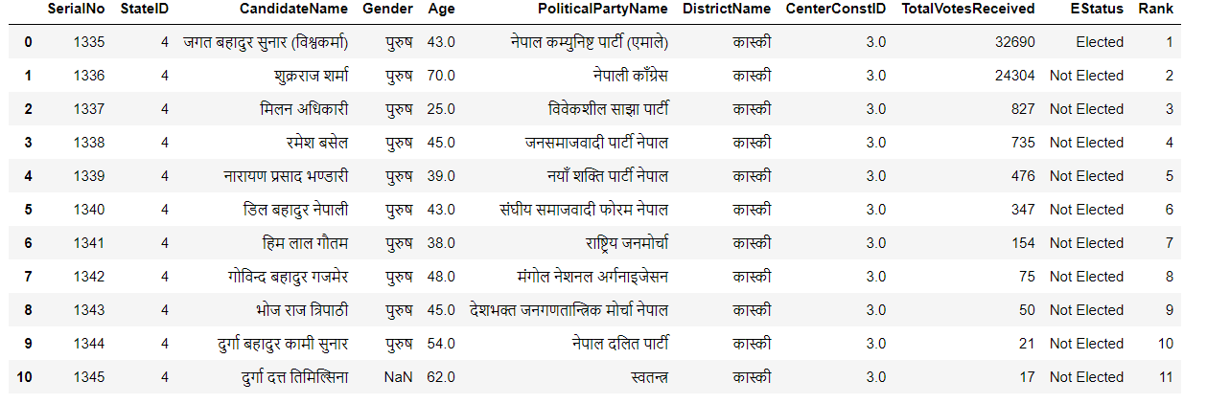
KASKI DATA FROM AREA 3:

Slide 8


Slide 9
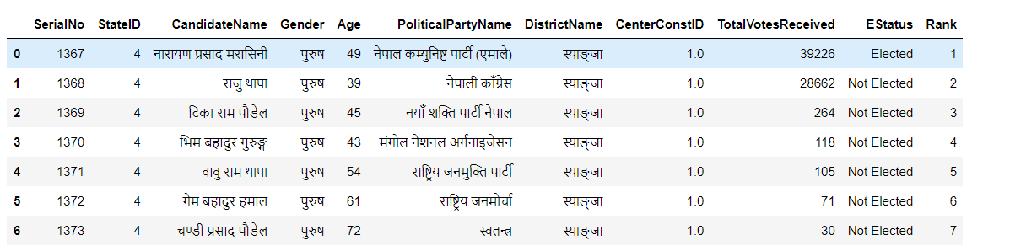
SYANGJYA DATA FROM AREA 1:

Slide 10
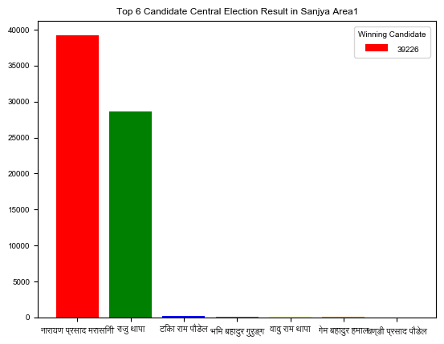

Slide 11
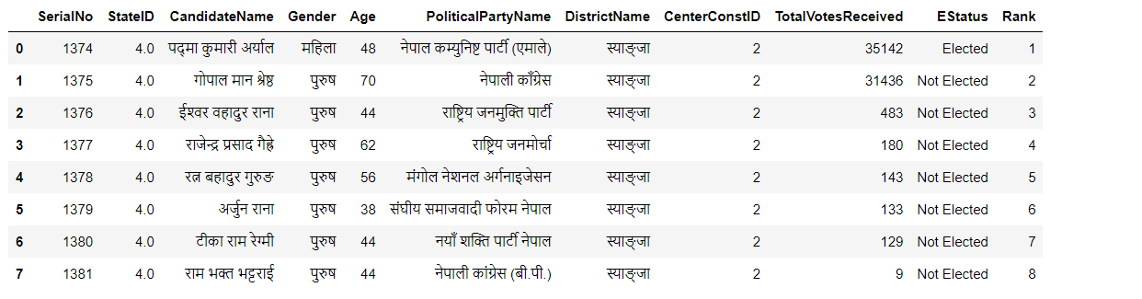
SYANGJYA DATA FROM AREA 2:

Slide 12
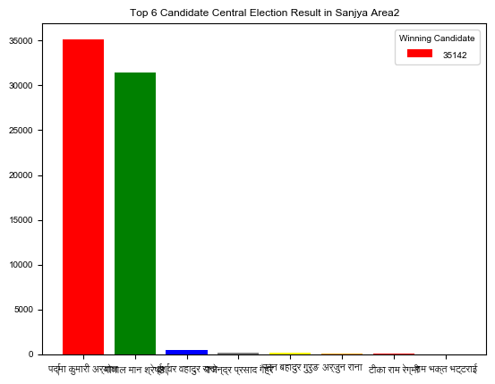

Slide 13
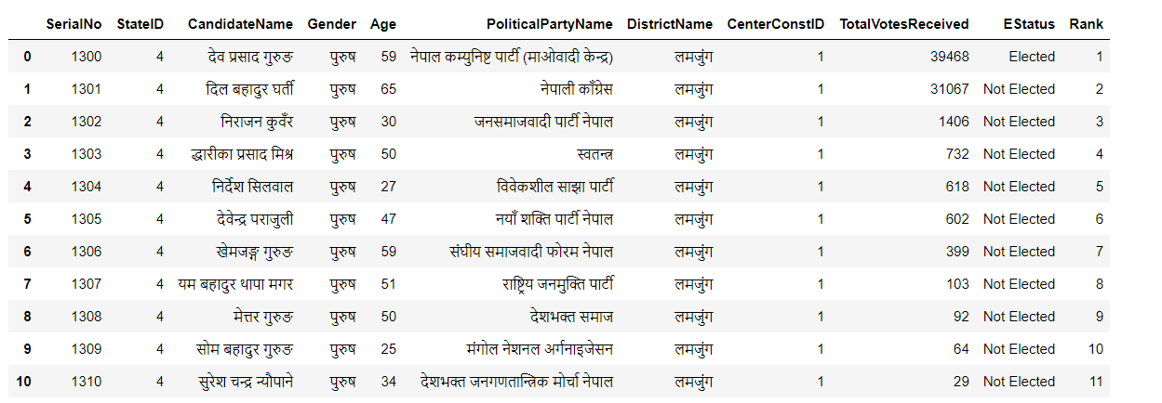
LAMJUNG DATA FROM AREA 1:

Slide 14
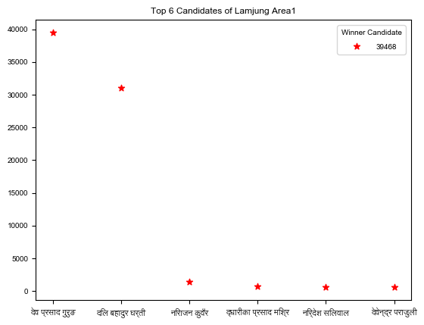

Slide 15
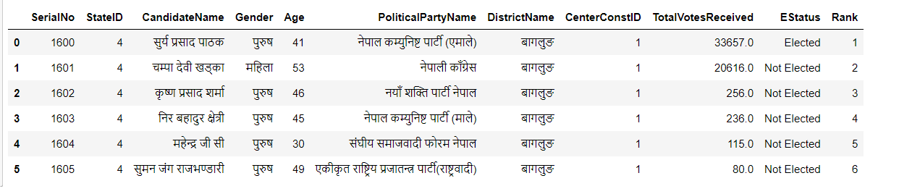
BAGLUNG DATA FROM AREA 1:

Slide 16
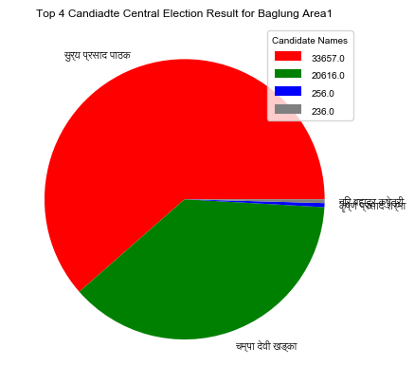

Slide 17
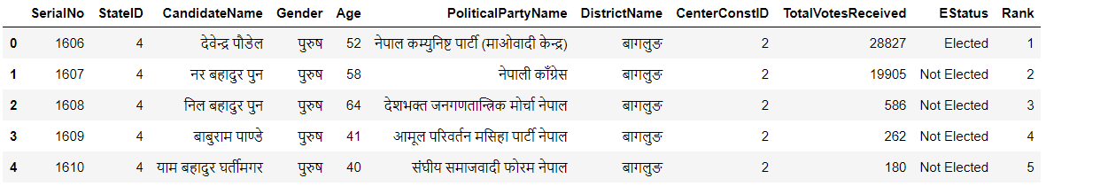
BAGLUNG DATA FROM AREA 2:

Slide 18
